Slide 1
Learning

Slide 2
What is Learning?
“a persisting change in human performance or performance potential . . . (brought) about as a result of the learner’s interaction with the environment” (Driscoll, 1994, pp. 8-9).
“the relatively permanent change in a person’s knowledge or behavior due to experience” (Mayer, 1982, p. 1040).
“an enduring change in behavior, or in the capacity to behave in a given fashion, which results from practice or other forms of experience” (Shuell, 1986, p. 412).

Slide 3
What ‘Is’ and ‘Isn’t’ learning?
IS: A relatively permanent change in an organism’s behavior due to experience.
ISN’T: reflex or effects of drug (temporary)
natural maturation (not experience)

Slide 4
Some examples:
Doping in Sport
Athletes taking illegal substances to improve their performances
Rio Olympics 2016 suffered a huge setback when wrestler Narsingh Yadav and shot-putter Inderjeet Singh were tested positive for banned substances by the National Anti-Doping Agency (NADA).
In 2000, discus thrower Seema was stripped of her gold at the World Junior Championships.
In 2005, discus throwers Anil and Neelam were handed
two-year ban for testing positive .
In 2010, shot putter Saurabh got a two-year ban for testing positive for banned stimulant.

Slide 5
Some Examples
Cheating in Exams
In 1997, IIT JEE was cancelled for the first time. The story is that a private coaching institute in Lucknow called its students 12 hours before the Physics and Chemistry exams for ‘last-minute tips’.
UPSSSC exam at one center cancelled over 'paper leak‘… Jul 18, 2016
Rajasthan University paper leaked on WhatsApp, exam cancelled
Bluetooth devices used in ‘leaking’ AIIMS paper too

Slide 6
Learning
Learning by Association
Classical Conditioning
Learning by Consequences
Instrumental/ Operant Conditioning
Learning by Observation
Social Learning Theory

Slide 7
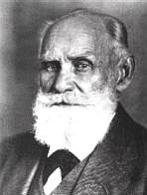
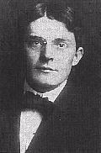
Types of Learning
Classical Conditioning
Operant Conditioning
Ivan Pavlov
John B. Watson
Social Learning
Behaviorism
“Forget the mind…”
Psychology should based on
observable behavior

Slide 8
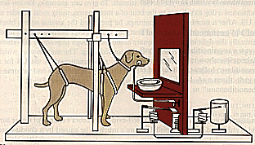
Classical Conditioning - Ivan Pavlov
Short Biography
20 years studying digestive system
30 years studying learning
1904 Nobel Prize in Medicine
A stimulus is presented
in order to get a response
S R

Slide 9
Classical Conditioning
Terms
Unconditioned Response
Unconditioned Stimulus
Conditioned Response
Conditioned Stimulus
UCS - food (triggers drool reflex)
UCR - drool in response to food (not learned)
CS - sound of bell (triggers drool reflex)
CR - drool in response to sound of bell (learned)

Slide 10
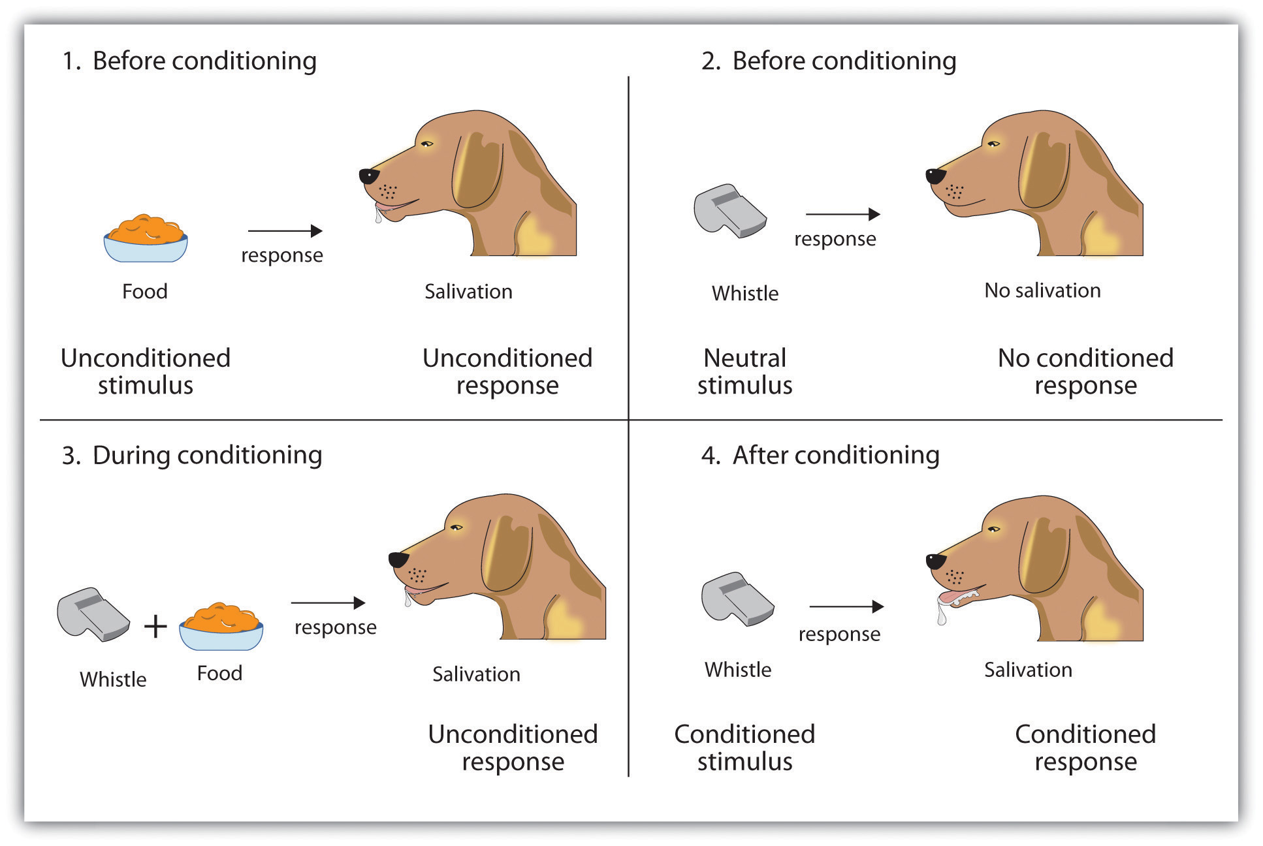

Slide 11
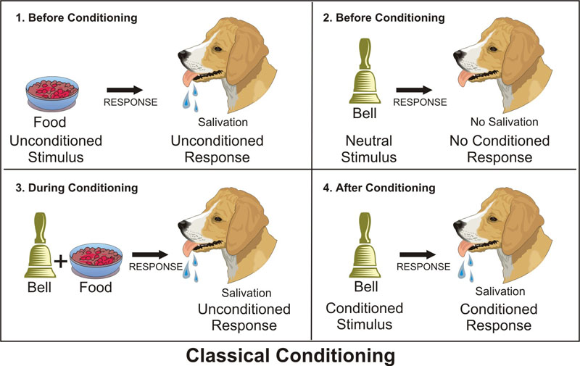
Notes:
First Order Classical Conditioning:
S = Stimulus (bell)
US = Unconditioned Stimulus (food)
UR = Unconditioned Response (saliva)
CS = Conditioned Stimulus (bell)
CR = Conditioned Reponse (saliva)

Slide 12
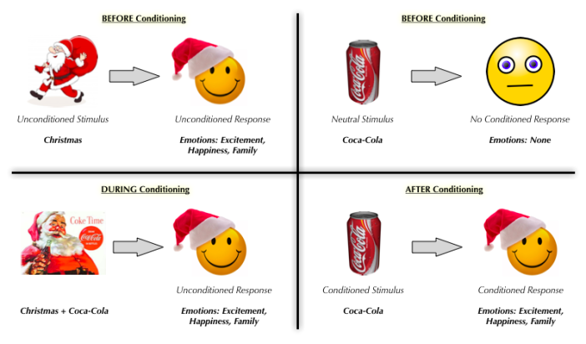

Slide 13
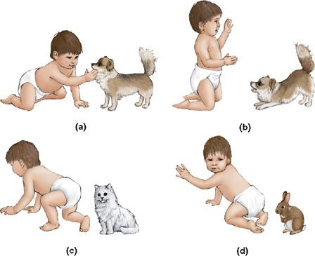
Classical conditioning in Humans
Fig. 8.7 Hypothetical example of a CR becoming a phobia. Child approaches dog (a) and is frightened by it (b). Fear generalizes to other household pets (c) and later to virtually all furry animals (d).

Slide 14
Five Major Conditioning Processes
Acquisition - Training period when a response is strengthened initial learning of the response
Extinction – Learning that CS no longer predicts the UCS
Spontaneous Recovery - Reappearance of the CR after some time period
Generalization - Tendency to respond to similar CS (e.g., a similar sounding bell)
Discrimination - Learned ability to distinguish between the CS and other stimuli

Slide 15
Behaviorism: Operant/ Instrumental Conditioning
Limitations of Classical Conditioning
CR often resembles the normal response to UCS
Learning a novel behaviour?
Operant or Instrumental conditioning
Certain Responses are learned because they operate on, or affect, the environment

Slide 16
Behaviorism: Operant Conditioning
Skinner
A type of learning in which behavior is strengthened if followed by reinforcement or diminished if followed by punishment
The frequency will increase if the consequence is reinforcing to the subject.
The frequency will decrease if the consequence is not reinforcing or punishing to the subject

Slide 17
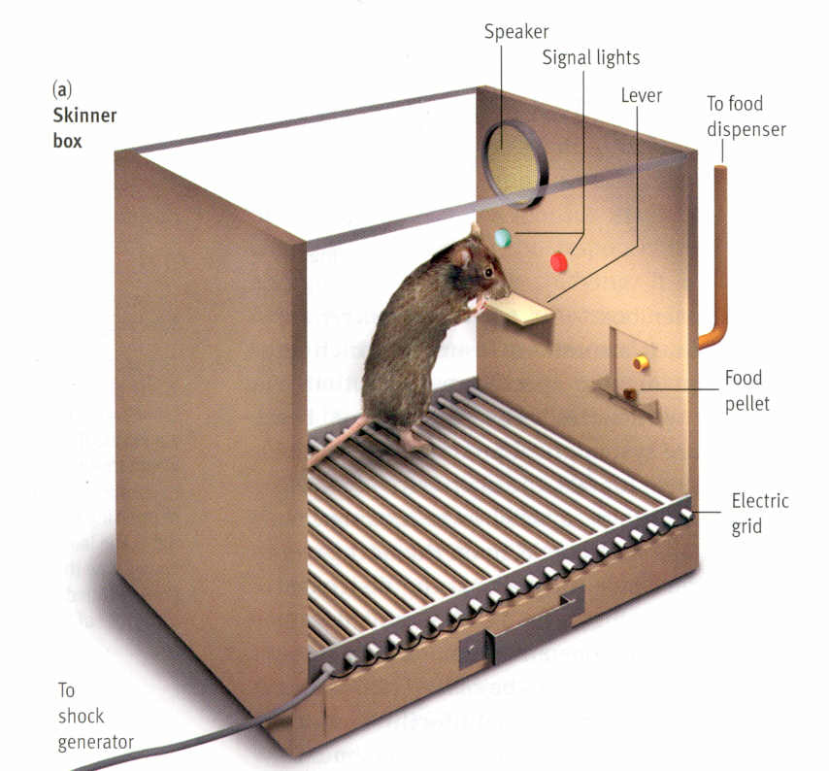
Skinner Box

Slide 18
Reinforcement/Punishment
Reinforcement - Any consequence that increases the likelihood of the behavior it follows
IS ALWAYS GOOD ???
Punishment - Any consequence that decreases the likelihood of the behavior it follows
The subject determines if a consequence is reinforcing or punishing

Slide 19
Types of Reinforcement

Slide 20
Principles of Reinforcement
Reinforcing/Desirable Stimulus
Aversive/UnDesirable
Stimulus
Stimulus is presented or added
Positive (+) Punishment
Add something you DO NOT LIKE.
Behavior Decreases
Positive (+) Reinforcement
Add something you DO LIKE.
Behavior Increases
Stimulus is removed or taken away from
Negative (-) Punishment
TAKES AWAY something you DO LIKE.
Behavior Decreases
Negative (-) Reinforcement
TAKES AWAY something you DO NOT LIKE.
Behavior Increases

Slide 21
Positive Reinforcement
Strengthens a response by presenting a stimulus that you like after a response
Anything that increases the likelihood of a behavior by following it with a desirable event or state
The subject receives something they want (added)
Will strengthen the behavior

Slide 22
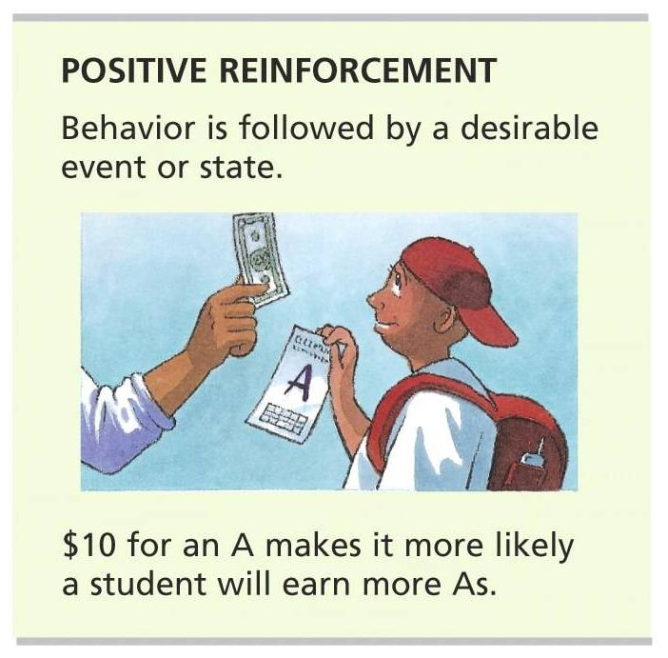
Positive Reinforcement

Slide 23
Negative Reinforcement
Strengthens a response by reducing or removing an aversive (disliked) stimulus
Anything that increases the likelihood of a behavior by following it with the removal of an undesirable event or state
Will strengthen the behavior
Neg. Rein. Allows you to either:
Escape something you don’t like that is already present (Neg. Rein. By Escape)
Avoid something before it occurs (Neg. Rein. By Avoidance)

Slide 24
How is this different from Punishment?
Negative Reinforcement will always increase a behavior (desirable)
Punishment will always decrease a behavior (undesirable)
Negative Reinforcement is something YOU DO to take away something bad.
Punishment is something DONE TO YOU that is bad and makes you stop doing a behavior.

Slide 25
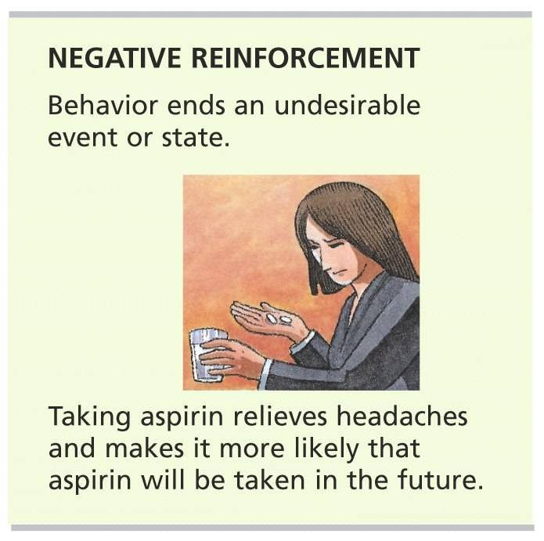
Negative Reinforcement

Slide 26
Punishment: The Process of Punishment

Slide 27
Types of Punishment
An undesirable event following a behavior
Behavior ends a desirable event or state
Its effect is opposite that of reinforcement – it decreases the frequency of behavior

Slide 28
Positive Punishment (Punishment by Application)
Something is added to the environment you do NOT like.
A verbal reprimand or something painful like a spanking

Slide 29
Negative Punishment (Punishment by Removal)
Something is taken away that you DO LIKE.
Lose a privilege.

Slide 30
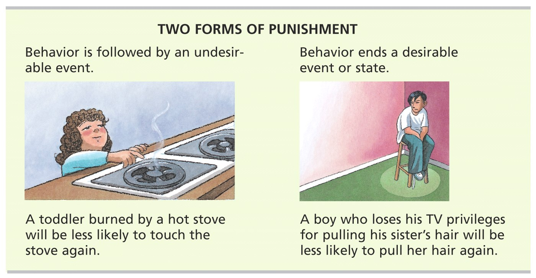

Slide 31
The Good Effects of Punishment
Punishment can effectively control certain behaviors if…
It comes immediately after the undesired behavior
It is consistent and not occasional
Especially useful if teaching a focuses on not to do a dangerous behavior
Most still suggest reinforcing an incompatible behavior rather than using punishment

Slide 32
Bad Effects of Punishment
Does not teach or promote alternative, acceptable behavior.
Only tells what NOT to do while reinforcement tells what to do.
Doesn’t prevent the undesirable behavior when away from the punisher in a “safe setting”
Can lead to fear of the punisher, anxiety, and lower self-esteem
Children who are punished physically may learn to use aggression as a means to solve problems.

Slide 33
Schedules of Reinforcement

Slide 34
Continuous Reinforcement
A schedule of reinforcement in which a reward follows every correct response
Learning occurs rapidly
But the behavior will extinguish quickly once the reinforcement stops.
Once that reliable candy machine eats your money twice in a row, you stop putting money into it.

Slide 35
Partial Reinforcement
A schedule of reinforcement in which a reward follows only some correct responses
Learning of behavior will take longer
But will be more resistant to extinction
Includes the following types:
Fixed-interval and variable interval
Fixed-ratio and variable-ratio

Slide 36
Fixed-Ratio Schedule
A partial reinforcement schedule that rewards a response only after some set number of correct responses
The faster the subject responds, the more reinforcements they will receive.
i.e. piece work: You get $5 for every 10 widgets you make.

Slide 37
Variable-Ratio Schedule
A partial reinforcement schedule that rewards an unpredictable average number of correct responses
High rates of responding with little pause in order to increase chances of getting reinforcement
This schedule is very resistant to extinction.
Sometimes called the “gambler’s schedule”; similar to a slot machine or fishing

Slide 38
Fixed-Interval Schedule
A partial reinforcement schedule that rewards only the first correct response after some set period of time
Produces gradual responses at first and increases as you get closer to the time of reinforcement
“Procrastinator Schedule”
Example: a known weekly quiz in a class, checking cookies after the 10 minute baking period.

Slide 39
Variable-Interval Schedule
A partial reinforcement that rewards the first correct response after an unpredictable amount of time
Produces slow and steady responses
Example: “pop” quiz in a class

Slide 40
Observational Learning
Basic Premise:
We learn behavior through observation
Vicarious reinforcement: Learn through observing consequences of behaviors of others
Bobo Doll Experiment
Identification vs. Internalization
Imitation vs. Assimilation

Slide 41
Four Steps of Observational Learning
Attentional processes
Retention processes
Production processes
Incentive and motivational processes

Slide 42
Observational Learning in Everyday Life
Antisocial behavior - negative, destructive, abusive, unhelpful behavior
Prosocial behavior – positive, constructive, helpful behavior
Both types of behavior can be modeled effectively.
How might TV programs effect the way we behave?

Slide 43
Shaping
Reinforcement of behaviors that are more and more similar to the one you want to occur
Technique used to establish a new behavior

Slide 44
Shaping Principles
Shaping - procedure in which rewards, such as food, gradually guide an animal’s behavior toward a desired behavior.
Successive approximations - shaping method in which you reward responses that are ever closer to the final desired behavior and ignore all other responses.
Shaping nonverbal animals can show what they perceive. Train an animal to discriminate between classes of events or objects.
After being trained to discriminate between flowers, people, cars, and chairs, a pigeon can usually identify in which of these categories a new pictured object belongs

Slide 45
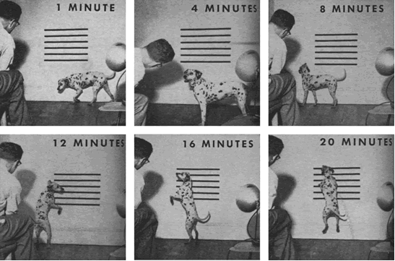
Skinner attached some horizontal stripes to the wall which he then used to gauge the dog's responses of lifting its head higher and higher. Then, he simply set about shaping a jumping response by flashing the strobe (and simultaneously taking a picture), followed by giving a meat treat, each time the dog satisfied the criterion for reinforcement. The result of this process is shown below, as it was in LOOK magazine, in terms of the pictures taken at different points in the shaping process. Within 20 minutes, Skinner had Agnes "running up the wall"

Slide 46
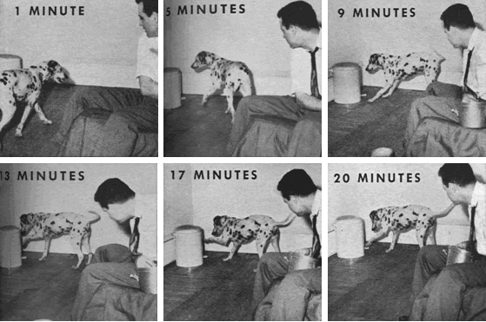
For the second shaping demonstration, Skinner trained Agnes to press the pedal and pop the top on the wastebasket. Again, the photographer's flash served as the conditioned reinforcer, and each step in the process was photographed. The results are shown below.

